Slide 1
Global Sustainable Leadership
2026

Slide 2

Personal introduction
Worked at Philips for 16 years including stints in China and the USA, marketing, sales and general management roles
Partner at NLC Health Ventures, world’s largest Health Tech Venture Builder
Board member at several HealthTec / Impact oriented businesses (PCA Vision, PEP.ai, Respiosa, MindAffect)
Extracurricular: President YPO Netherlands, Approporiation Committtee KWF, lecturer in Amsterdam and now Tilburg
Partner at NLC Health Ventures

Slide 3


Slide 4











A more personal introduction
Happy child…
…study in Groningen…
…join Philips…
…marry Veronique…
…start an international career…
…3 girls, all made in China…
…Veronique falls ill…
…death of Derk

Slide 5



Roll up your sleeves and create a better future
“The best way to predict the future is to create it”
Peter Drucker
“At some point, you realize that success without significance is just noise”
Inspired by Paul Polman

Slide 6
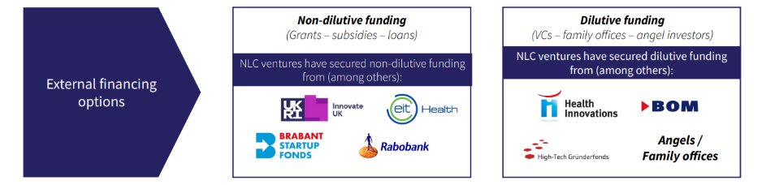
Building an Impact Venture starts with fundraising
These funds do not dilute ownership
Loans
Grants
Subsidies
These funds dilute ownership
Equity investment
Convertible loans

Slide 7
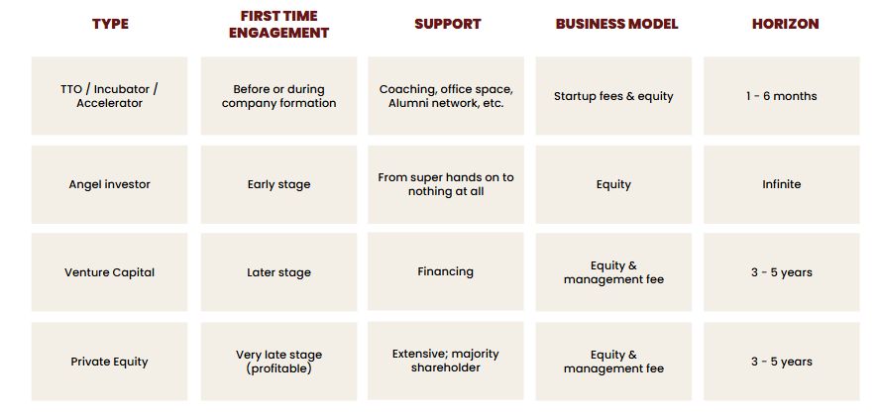
Dilutive financing: different sources for different stages
Early…
…later

Slide 8
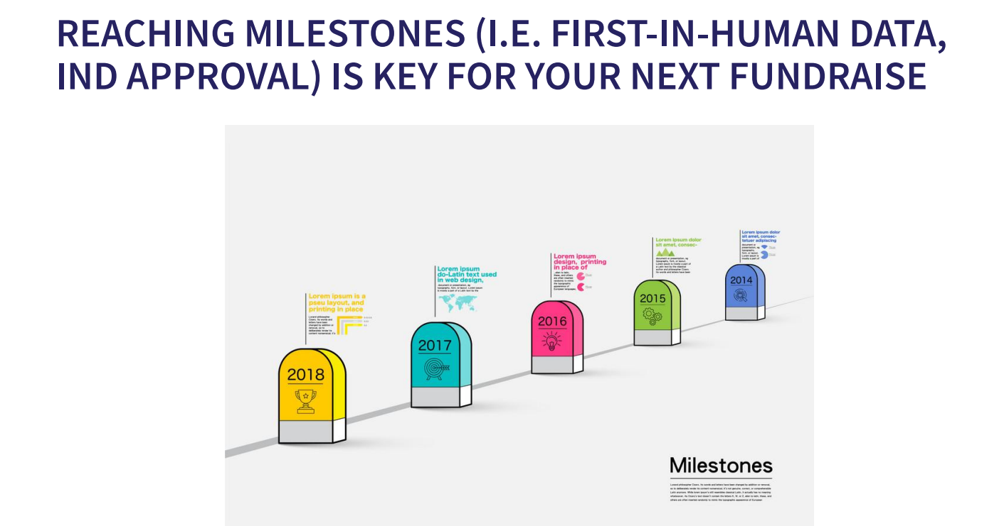
Milestone: an agreement to hit a value inflection point
Value Inflection Point: the venture will be worth more after this. Example: the product is working, there is a customer, there is (significant) revenue

Slide 9
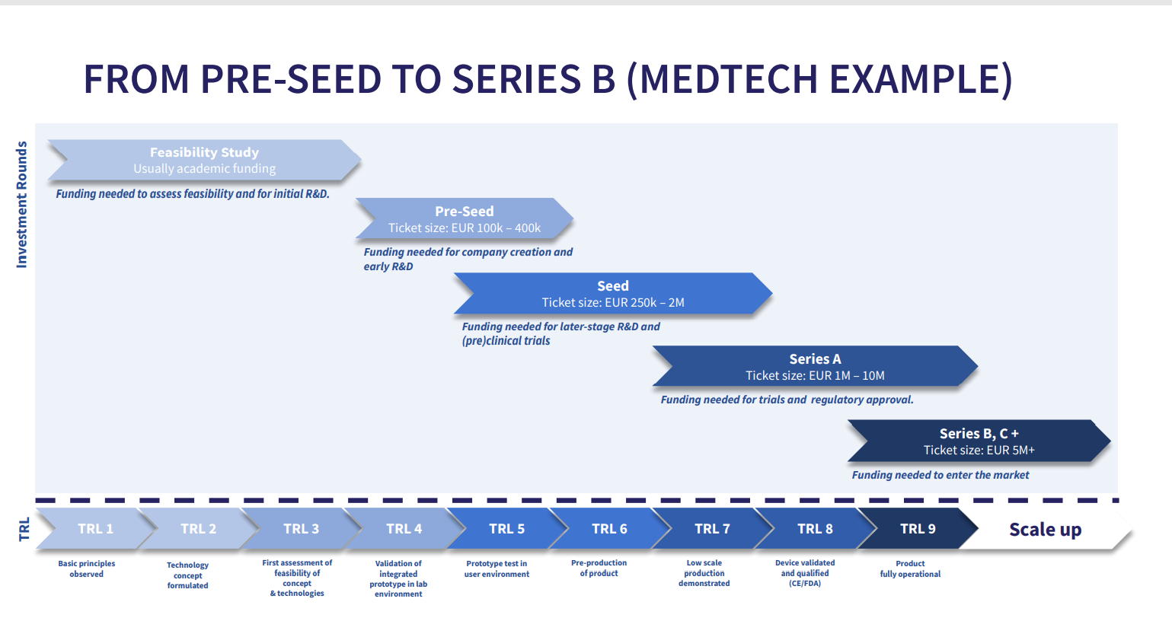
Financiers use standard names for milestones: series X

Slide 10
Cap table: who owns what percentage of the company
Sample: what happens over time to shareholder % (=cap table) as more investors join…
…Learnings and watch-outs when taking on dilutive investment
Dilution sounds scary but is good as long as your stake is becoming more valuable
With dilution comes changes in ownership = change in who controls what
Watch out for ‘special rights’, very often, founders end up with nothing, even if the company is sold for millions
 | Incorporation | Pre-seed round | Pre-seed cap table | Seed round | Seed cap table
Founders | 80% |  | 64% |  | 48%
University | 20% |  | 16% |  | 12%
Angel investor |  | 250,000 | 20% |  | 15%
Venture Capital |  |  |  | 1,000,000 | 25%
Pre-money valuation |  | 1,000,000 |  | 3,000,000
Post-money valuation | 0 |  | 1,250,000 |  | 4,000,000

Slide 11
P&L: Do you see numbers or can you look beyond?
P&L
CSG -2.4% CSG, 11.7% lower than Sep FC or EUR -14.1M. -9.9M sales in NAM mainly related to operational issues and softening of demand -2.4M sales in Greater China mainly related to supply shortages -2.2M sales in Japan due to softening in demand
IGM -2M or 1.7% impact of GIT write of in NAM -3.4M or 2.9% unknown, deep dive has been initiated
TPW 0.3M higher than FC or -0.5% of sales
A&P 2.8M lower or 0.5% of sales, all in retail 1.1M lower in NAM 0.6M lower in GC
OFSE -0.3M higher than Sep FC or 1.6% of sales, all in rtail 0.5M higher spend in NAM (validate retail comments which indicate this will be corrected in November)
R&D +0.2M lower than SEP FC. -0.3% higher as % of sales
G&A -+0.2M lower than Sep FC, mainly in Discus and NL HQ
Adj EBITA -2.1% lower than Jun FC, or -8.4M. Mainly related to lower margins -0.9% paired with -1.1% higher NMC despite -4.7M savings in value

Slide 12
P&L: Do you see numbers or can you look beyond?
P&L
CSG: ComparableSales Growth Is your business growing or shrinking In which geographies In which segments
IGM: Integral Gross Margin How profitable is your product, purely taking your price – the product cost Only moving parts: your price and your cost price. Hard to change Very important to investors
TPW Transportation, Packaging and Warehousing
A&P: Advertising and Promotion
OFSE Other Fixed Selling Expenses Sales force Service Implementation
R&D: Research & Development
G&A: General and Administrative Your salary as CEO
Adj EBITDA: Ernings before Interest, Taxes, Depreciation, Amortization ‘Clean’ profit

Slide 13
It does not stop with your P&L… others need $ as well
…VAT (BTW)…
21%
221!!
Distribution is very expensive. This has to feed into your business plan
Final customer price is the starting point. This dictates your ‘should’ cost price
…Retail margin…
100%
200
Your price
100
Your cost price
-
30
Your gross margin
=
70
All other costs
-
40
Your EBITDA
=
30

